Slide 1
Agenda Item 11: Update on Groundwater Model Development
Bill Hutchison
August 14, 2024

Slide 2
Topics
Geologic Update and Updated Model Grid
Tech Memo Status
Permitted Well Aquifer Completion
Rainfall Event of July 23, 2024

Slide 3
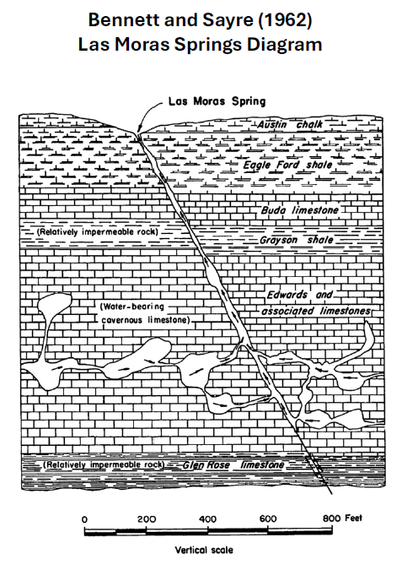

Slide 4
Geologic Update Resulted in Modified Model Layering
Layer 1 = Alluvium
Layer 2 = Austin Chalk
Layer 3 = Eagle Ford Shale
Layer 4 = Grayson Shale (Del Rio Clay)
Layer 5 = Georgetown Limestone (Salmon Peak)
Layer 6 = McKnight Formation
Layer 7 = West Nueces Formation
Layer 8 = Glen Rose

Slide 5
Geologic Update Resulted in Modified Model Layering
Layer 1 = Alluvium
Layer 2 = Austin Chalk
Layer 3 = Eagle Ford Shale
Layer 4 = Grayson Shale (Del Rio Clay)
Layer 5 = Georgetown Limestone (Salmon Peak)
Layer 6 = McKnight Formation
Layer 7 = West Nueces Formation
Layer 8 = Glen Rose
Edwards Aquifer

Slide 6
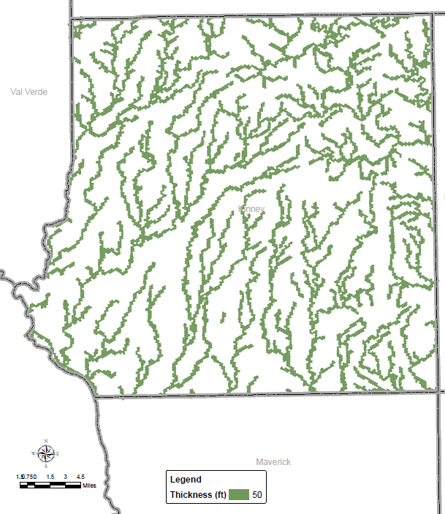
Alluvium Thickness (Layer 1)

Slide 7
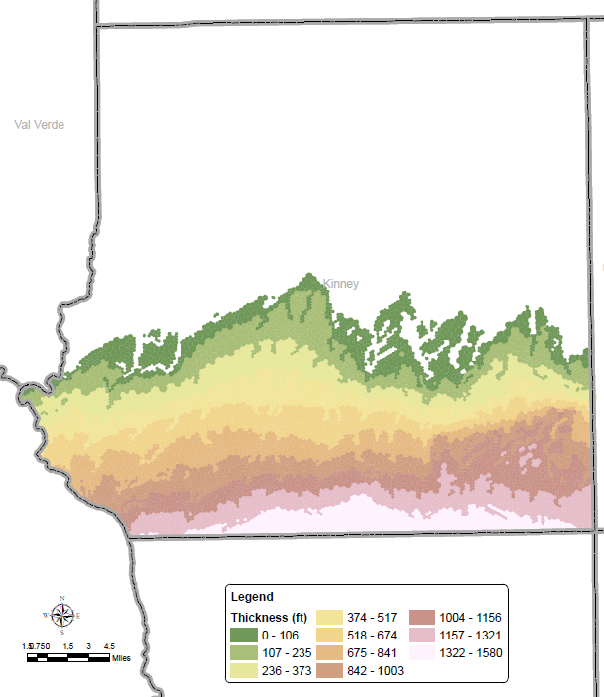
Austin Chalk Thickness (Layer 2)

Slide 8
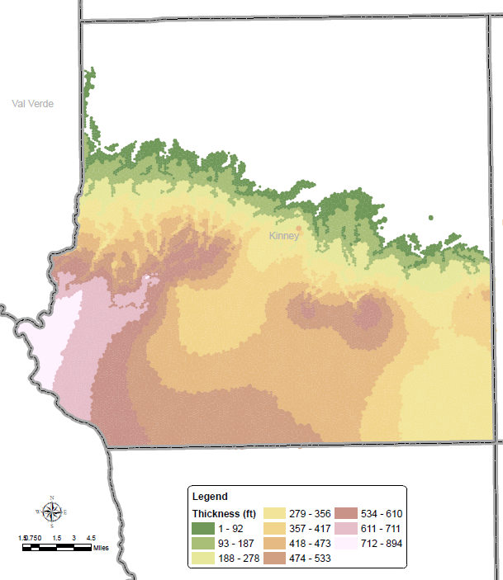
Eagle Ford Shale Thickness (Layer 3)

Slide 9
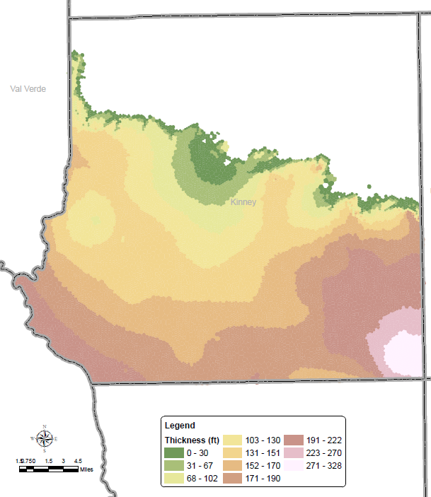
Grayson Shale (Del Rio Clay) Thickness (Layer 4)

Slide 10
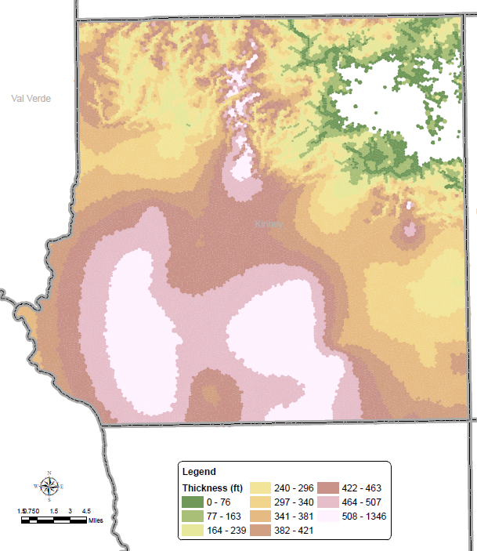
Georgetown Limestone (Salmon Peak) Thickness
(Layer 5)

Slide 11
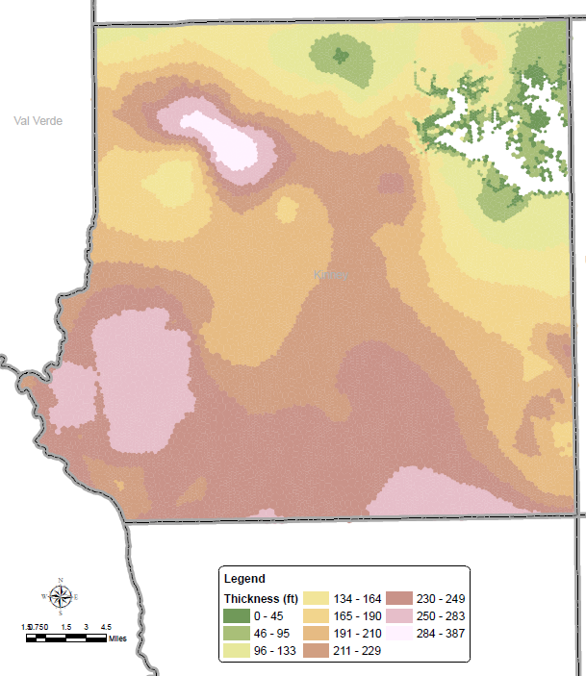
McKnight Formation Thickness (Layer 6)

Slide 12
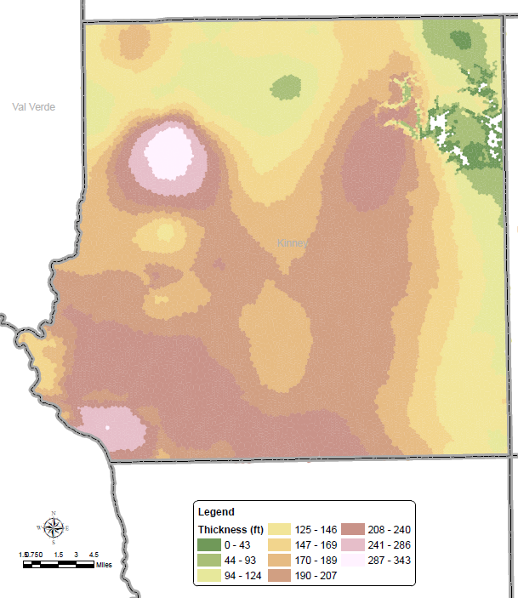
West Nueces Formation Thickness (Layer 7)

Slide 13
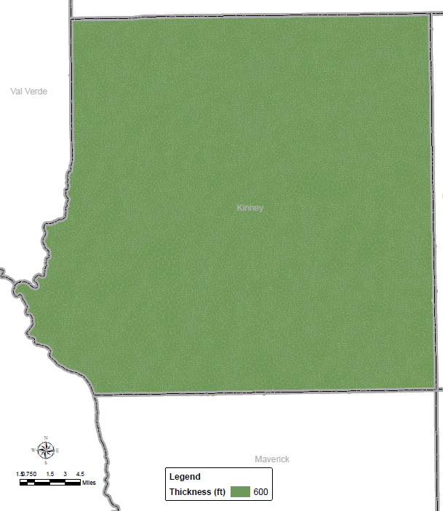
Glen Rose Thickness (Layer 8)

Slide 14
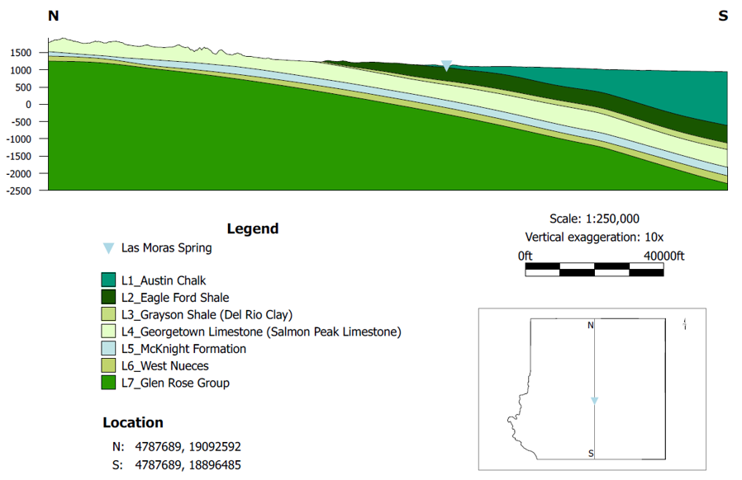
North-South Geologic Cross Section
Las Moras Spring
Las Moras
Spring

Slide 15
Updated Model Grid
Processed geologic data into new model grid
129,111 cells in variable grid (8 layers)
Grid limited to Kinney County
Small cells associated with surface water features (karst terrain and focused recharge)
Most cells are less than 50 acres
Top and bottom elevation of each cell defined in grid
Updated Tech Memo on model grid partly completed

Slide 16
Tech Memo Status
Completed processing most of groundwater elevation data (monitoring wells)
Updated analysis of satellite data for irrigation water use estimates will be completed in early September (to extend calibration period)
Permitted well data
Historic production data development complete
Location and well depth complete
Other Tech Memos for individual model packages need to be updated with new model grid and extended calibration period

Slide 17
Current Management Zones
Two-dimensional zones based on correlations between
Groundwater elevations in monitoring wells
Las Moras Spring flow
Completed as a place holder for management plan (late 2022)
Need to update with more direct link to permitted wells

Slide 18
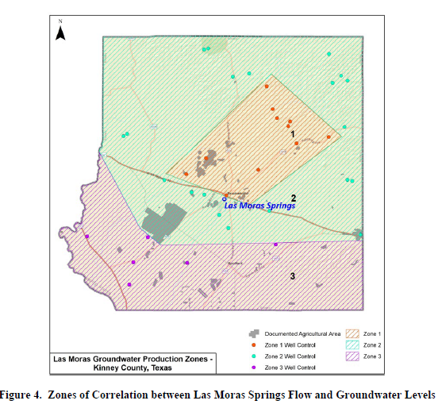

Slide 19
Update to Aquifer Designations
115 Permitted Wells
Location coordinates all verified
82 have depth data
Some are questionable (i.e. round numbers)
3 have estimated data (i.e. “1,000+”)
30 have no depth estimate
With good location data, need to complete work to assign each well to model grid cell
Wells with questionable, estimated, or no depth data will be designated with a provisional aquifer pending further analysis

Slide 20
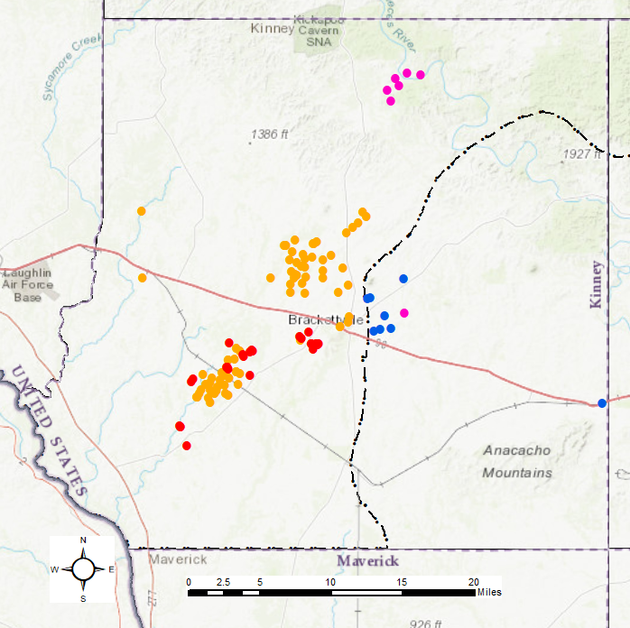
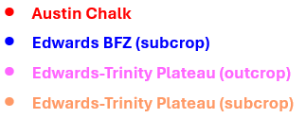
KCGCD Permitted Well Locations
Aquifer Designation Based on Permit Documentation
(Needs to be Corrected with Updated Geology)
GMA 7
GMA 10

Slide 21
Permitted Wells and Zones
Objective: Assign each permitted well to a zone associated with potential to impact Las Moras Springs
Three-dimensional concept based on location and completion of well (e.g. Austin Chalk vs. Edwards)
Combination of data and model results will be used
Example of how data can be used to inform zone assignment is response from rainfall event of July 23, 2024
Model can be used to supplement, interpolate, extrapolate data

Slide 22
Rainfall Event of July 23, 2024
Rainfall summary
Las Moras Spring flow response to rainfall
Groundwater level response to rainfall
For context, compared event rainfall and spring flow with statistical analysis completed last year (TM 23-16)

Slide 23
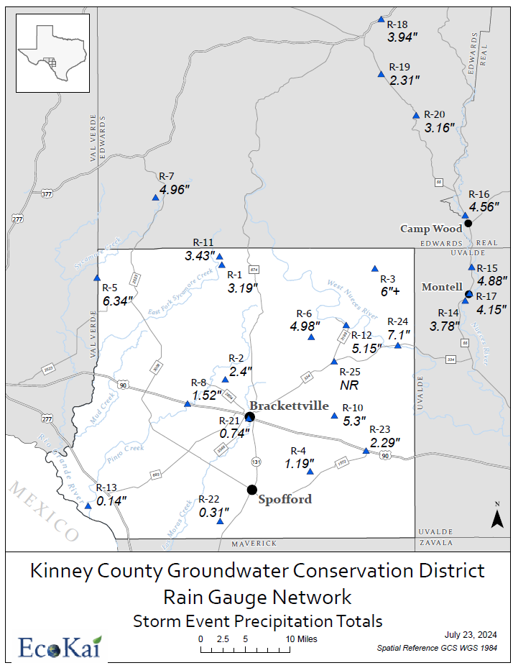

Slide 24
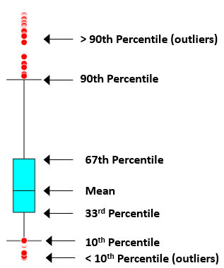
Box and Whisker Plot Legend

Slide 25
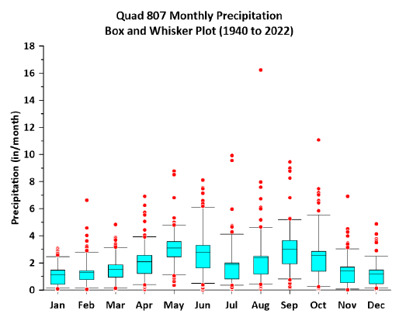

Slide 27
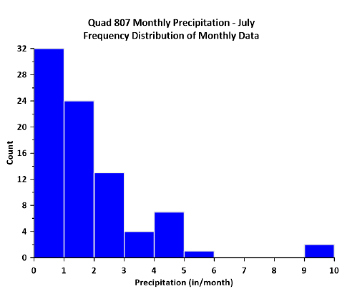

Slide 29
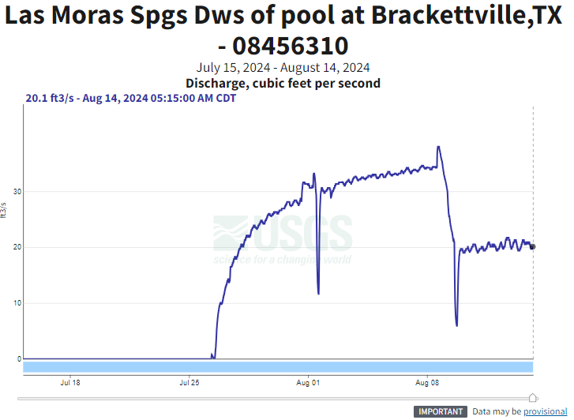

Slide 30
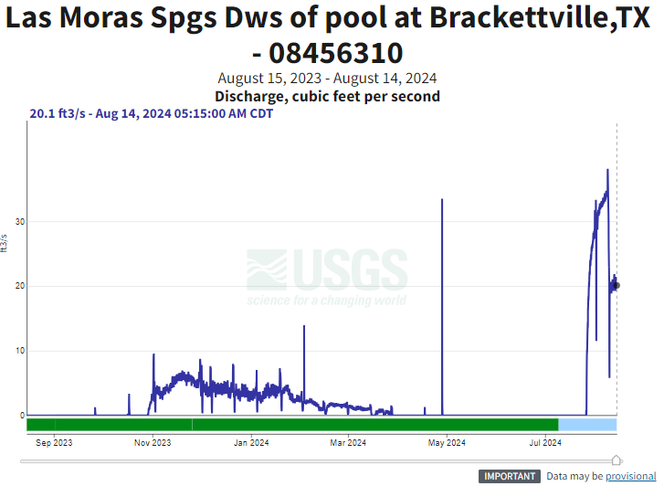

Slide 31
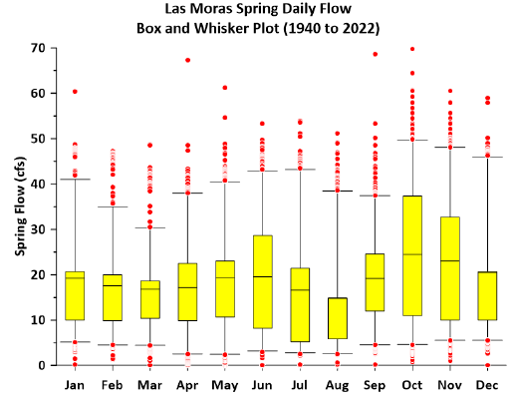

Slide 33
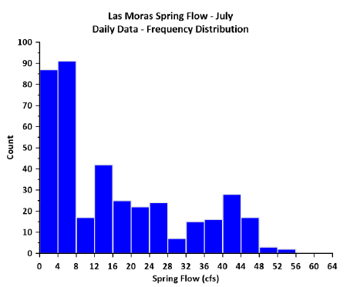

Slide 35
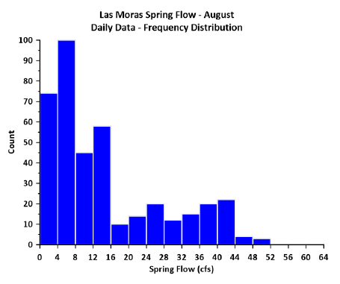

Slide 37
Rainfall and Recharge
TM 23-10 estimated recharge based on rainfall
Rainfall in winter has a higher recharge rate than rainfall in summer (evaporation)
For summer quarter (July to September) – recharge to Edwards formation (old model designation):
3.13 in rainfall = 7,238 AF recharge
6.14 in rainfall = 14,198 AF recharge

Slide 38
Approximate Spring Flow Conversions
Spring flow of 30 cfs
60 AF/day
1,800 AF/month
Spring flow of 20 cfs
40 AF/day
1,200 AF/month

Slide 39
Groundwater Level Response
Some wells increased more than others
Aquifer completion (Edwards vs. Austin Chalk)
Location of rain

Slide 40
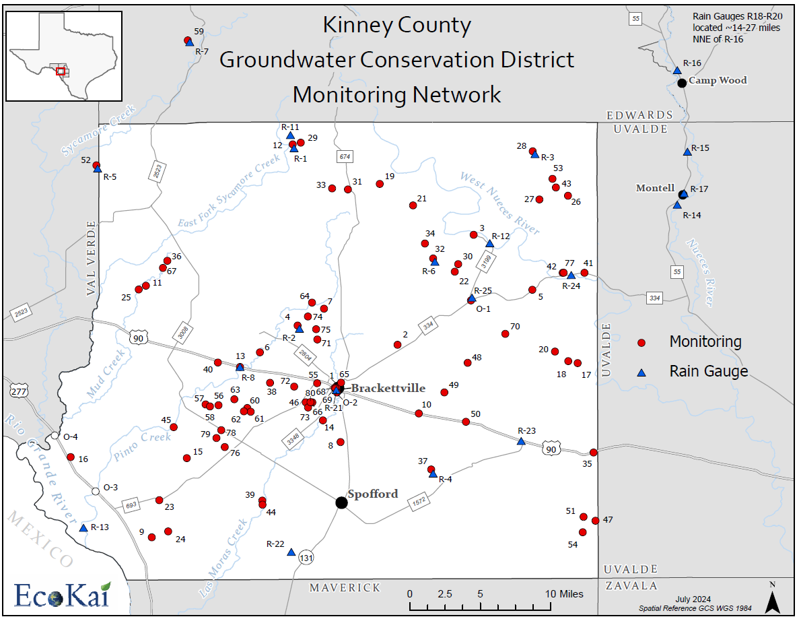

Slide 43
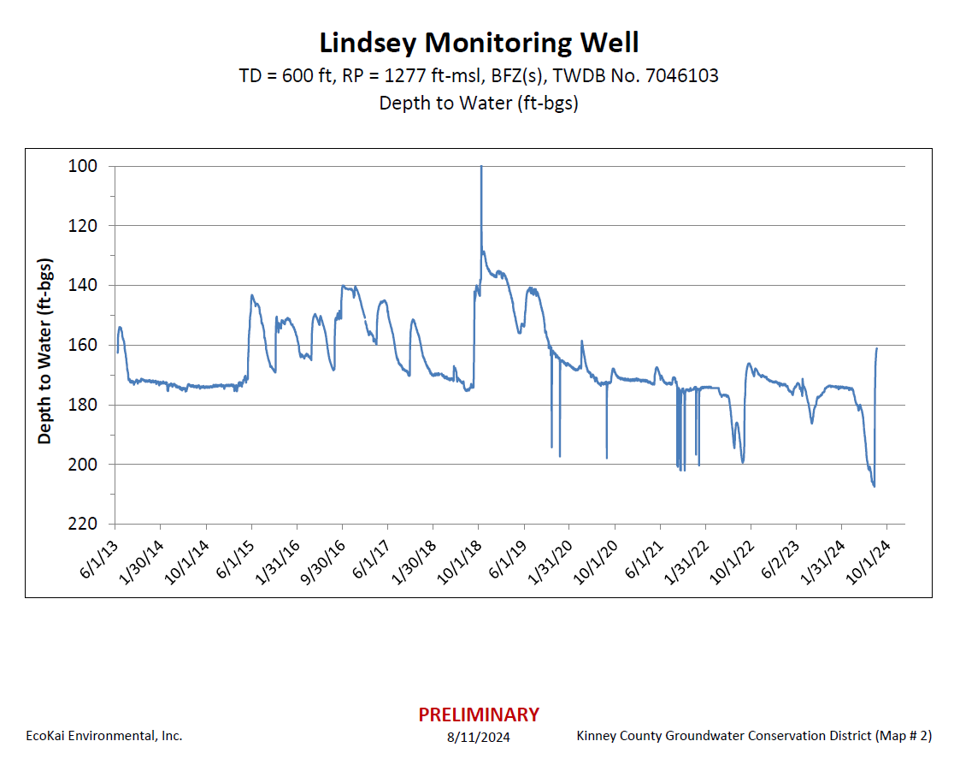
About 6 miles NW of
Brackettville on 334

Slide 44
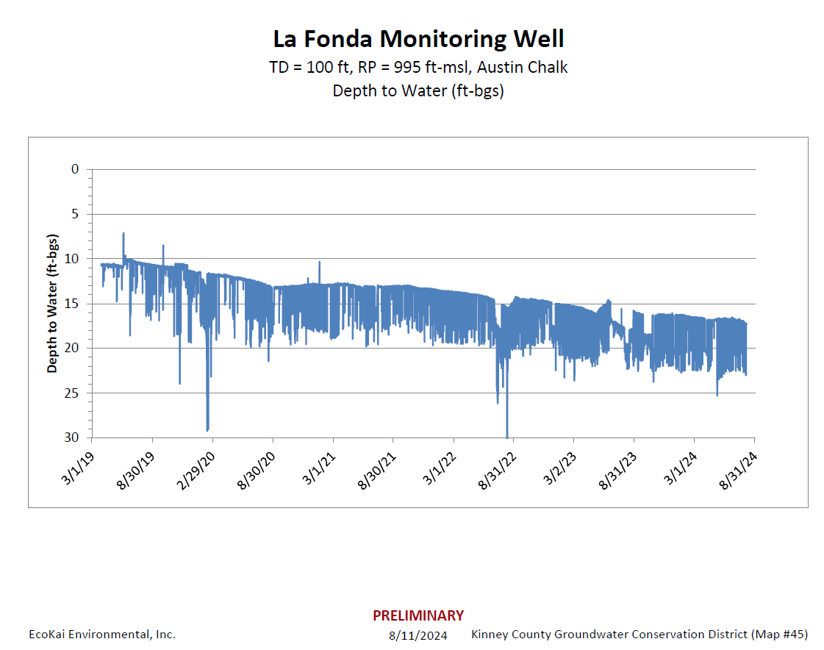
Adjacent to Pinto Creek
Southwest of 3008

Slide 45
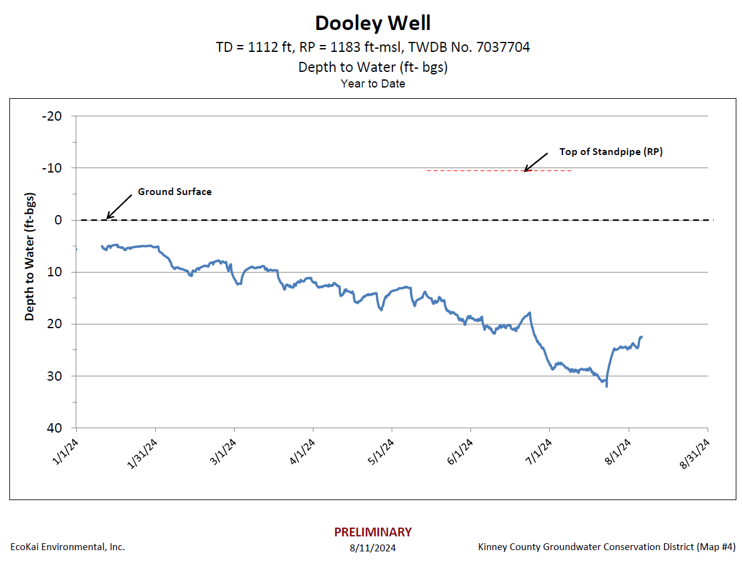

Slide 46
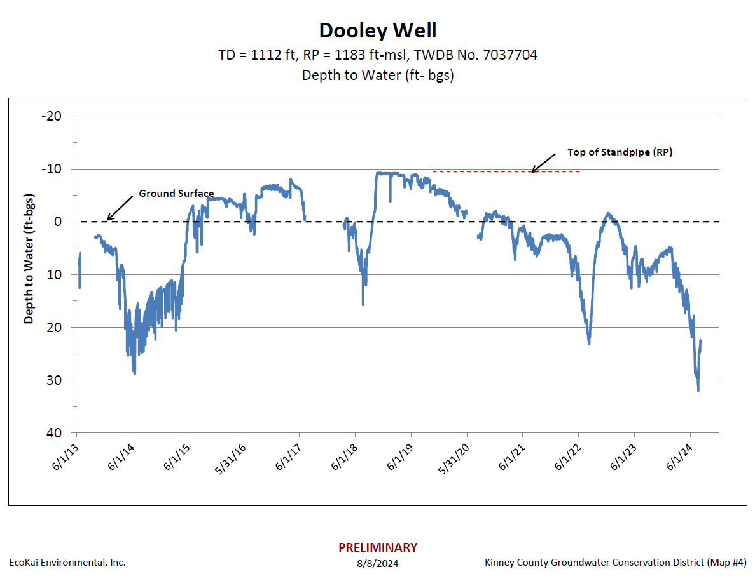

Slide 47
Upper Part of Pinto Valley
Shahan

Slide 48
Pinto Creek Area

Slide 49
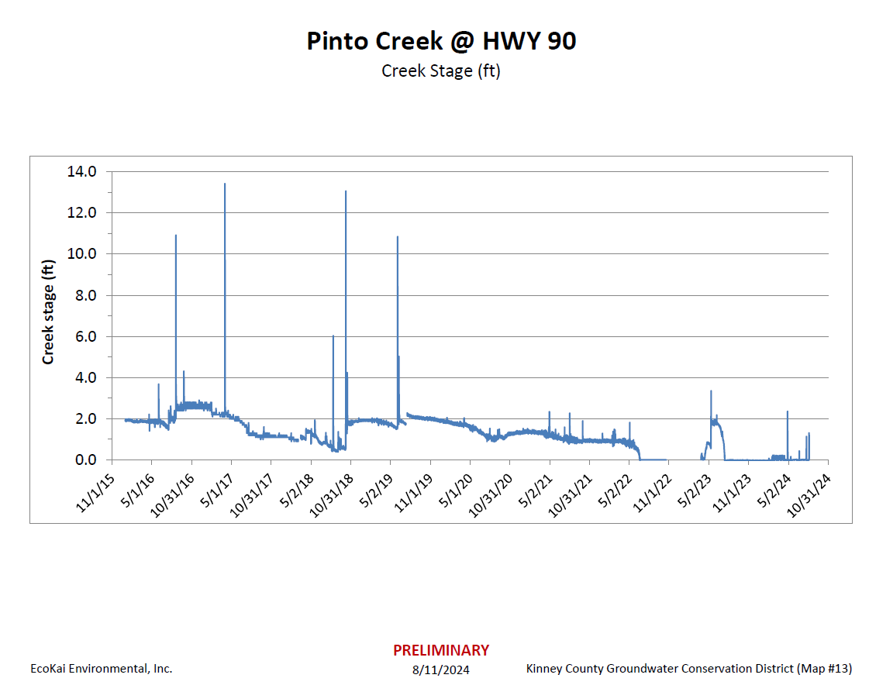

Slide 50
Las Moras Spring vs. Pinto Valley
Las Moras Spring, FCS wells, and City of Brackettville wells
May be part of a deeper flow system
Benefitted from rain in northeast part of Kinney County and north of Kinney County
Pinto Valley
May be limited to a shallow flow system
Less rain than other areas
Did not benefit as much in terms of groundwater level recovery

Slide 51
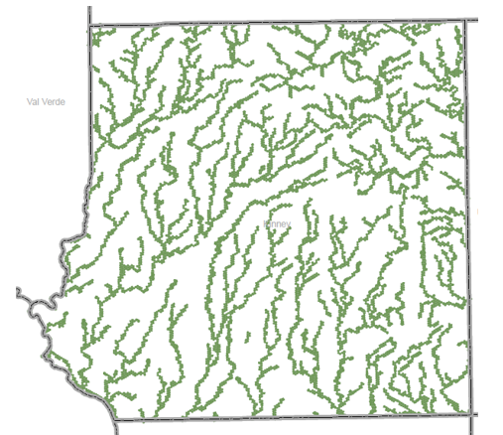
Possible Flow Paths
(To Be Tested with Model)
“Shallow” Flow
System

Slide 52
Possible Flow Paths
(To Be Tested with Model)
“Deep” Flow
System

Slide 53
Possible Flow Paths
(To Be Tested with Model)
“Shallow” Flow
System
“Deep” Flow
System

